Slide 1

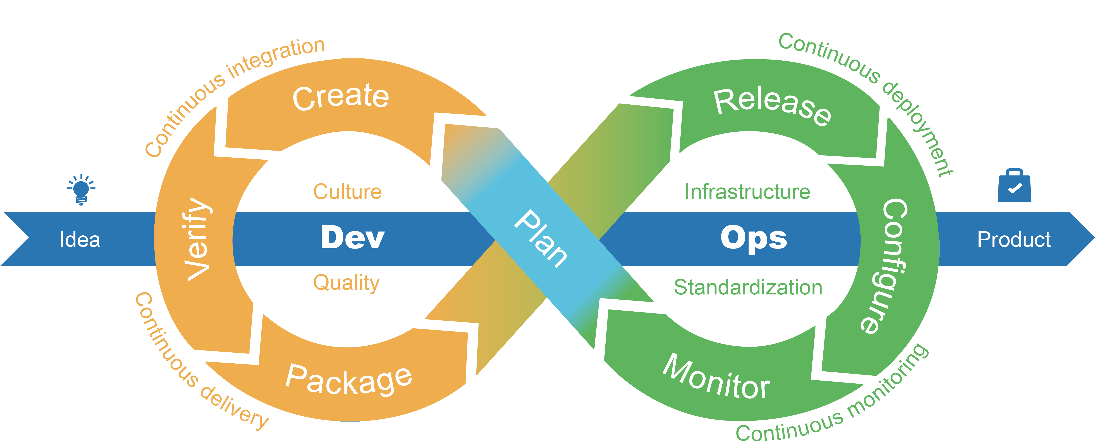
AWS DEVOPS WITH ASEEM

Slide 2
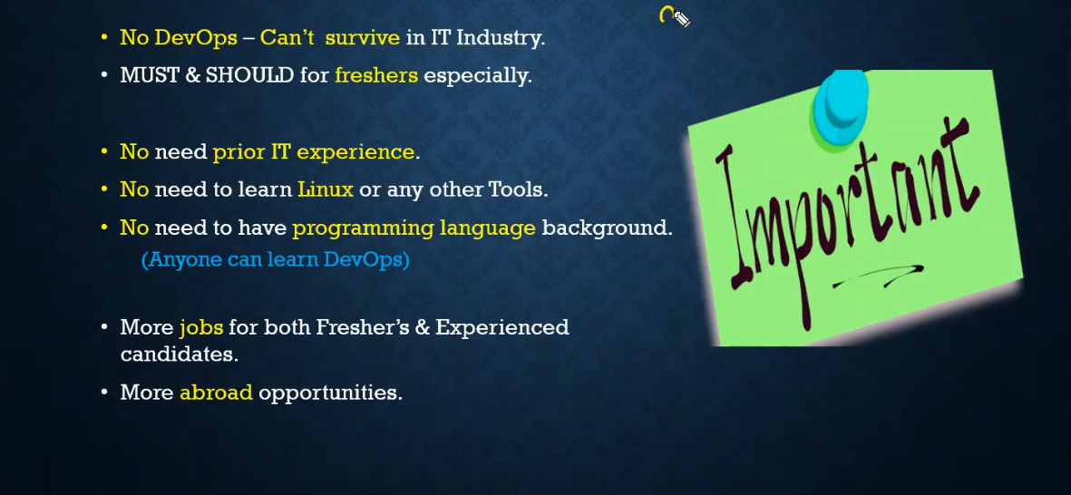

Slide 3
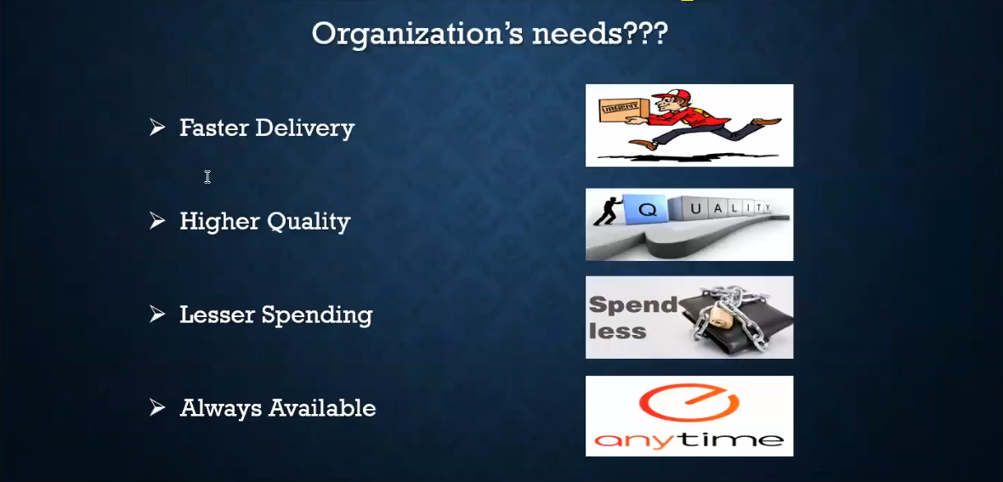

Slide 4
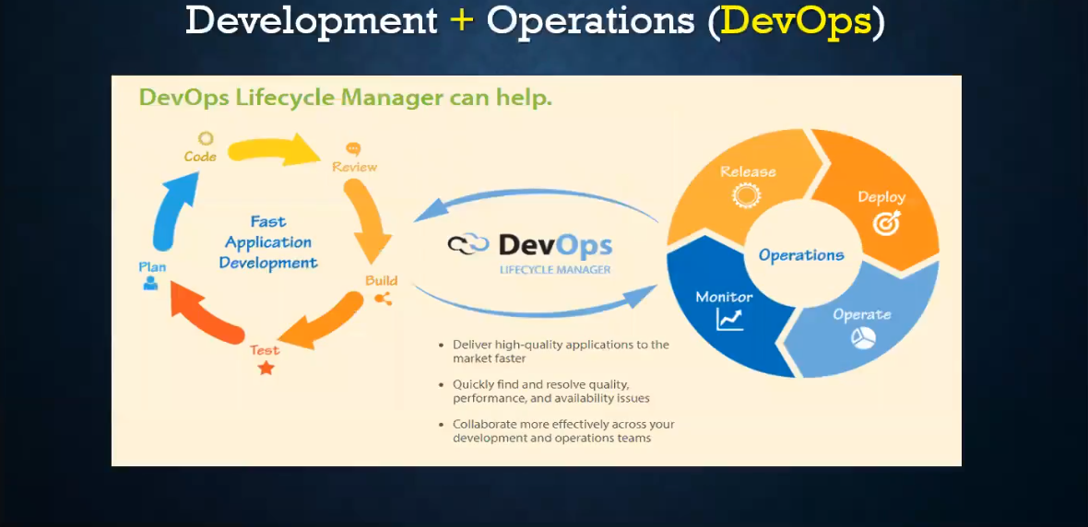

Slide 5
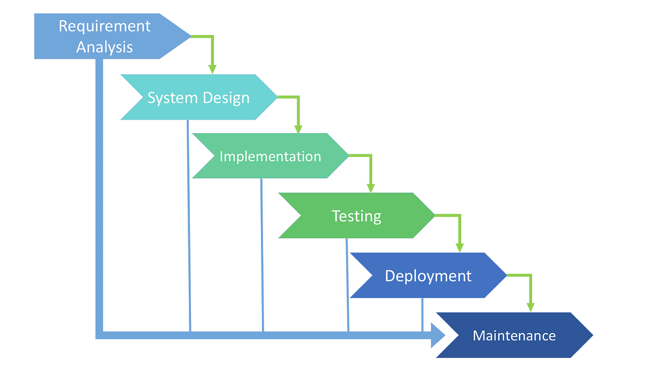
WATERFALL METHODOLOGY

Slide 6
Waterfall model was the first process model to be introduced. It is very simple to understand and use. Waterfall is the most traditional model.
In waterfall approach, the whole process of the software development is divided into separate phases. The outcome of one phase acts as the input for the next phase sequentially.
This means that any phase in the development process begins only if the previous phase is complete.

Slide 7
Disadvantages of waterfall model
It does not allow for much reflection or revision.
It is difficult to estimate time and cost for each phase of the development process.
Not a good model for complex and object-oriented projects.
Not suitable for the projects where requirements are at a moderate to high risk of changing.
Poor model for long and ongoing projects.
Once an application is in the testing stage, it is very difficult to go back and change something that was not well-thought out in the concept stage.
No working software is produced until late during the life cycle.

Slide 8
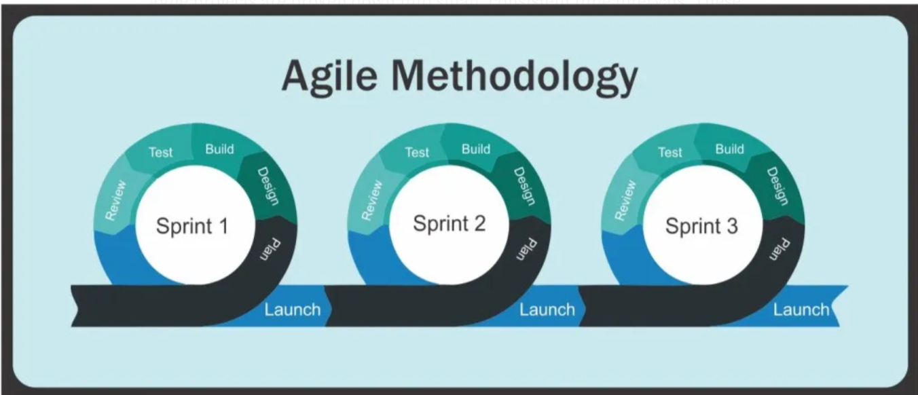
AGILE METHODOLOGY

Slide 9
Agile Model
Agile breaks down the larger projects into small, manageable chunks called iterations. At the end of each iteration (which generally takes place over a consistent time interval) something of value is produced.

Slide 10
Advantages of Agile model
Working software is delivered frequently
Customer satisfaction by rapid, continuous delivery of useful software.
People and interactions are emphasized rather than process and tools. Customers, developers and testers constantly interact with each other.
Even late changes in requirements are welcomed
Face-to-face conversation is the best form of communication.

Slide 11
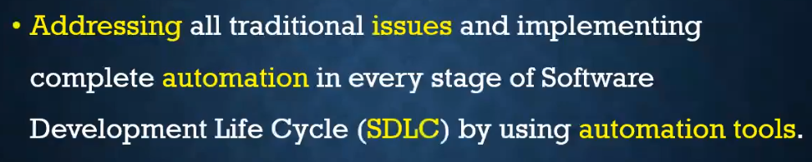
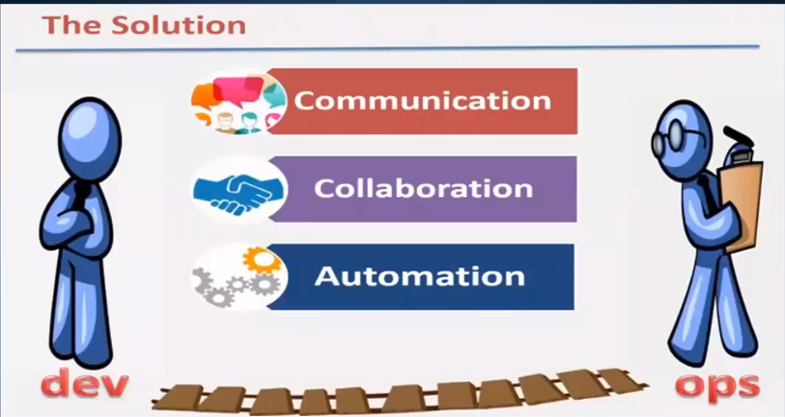

Slide 12
